Slide 1


DEPARTMENT OF COMPUTER SCIENCE AND ENGINEERING VIDYAVARDHAKA COLLEGE OF ENGINEERING
DESKTOP-BASED PERSONAL VOICE ASSISSTANT
ABHISHEK L [4VV20CS004]
Department of Computer Science & Engineering

Slide 2
OVERVIEW
Abstract
Introduction
Problem Statement
Objective
Existing System
Proposed Idea
Model
Reference

Slide 3
ABSTRACT
The project aims to develop a virtual assistant for a Windows-based system. Jarvis draws its inspiration from virtual assistants like Cortana for Windows, and Siri for iOS. It has been designed to provide a user-friendly interface for carrying out a variety of tasks by employing certain well-defined commands.
Users can interact with the assistant either through voice commands or using keyboard input.
As a personal assistant, Jarvis assists the end-user with day-to-day activities like a general human conversation, searching queries in google or Yahoo, searching for videos, playing songs, live weather conditions, word meanings, searching for medicine details, and reminding the user about the scheduled events and tasks.

Slide 4

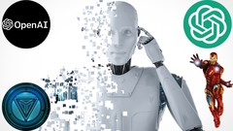
INTRODUCTION
A virtual assistant, an application program adept at understanding natural language and voice commands, empowers users to commandeer machines like laptops and PCs. It efficiently handles tasks such as displaying the date and time, managing emails, and launching applications, all at the user's behest.
In today's fast-paced world, virtual assistants have become indispensable, streamlining tasks and allowing for the hands-free operation of computers.
They are cloud-based, necessitating an internet-connected device. These assistants are task-focused and proficient in comprehending and executing requests.
The Windows virtual assistant leverages Artificial Intelligence and Python for its robust library support. Utilizing a microphone for input and a speaker for output, it employs voice recognition, analysis, and language processing technologies.

Slide 5

Problem Statement
There is an increasing need to depend less on traditional screen interactions in an ever-changing digital environment where speed, efficiency, and convenience are prioritized.
To meet these changing user expectations, the problem statement therefore calls for the creation of a sophisticated virtual assistant. virtual assistant accessible for Windows developers in paradise.
Giving input through voice is not only beneficial for normal people but also for those who are visually impaired and are not able to give input by using a keyboard.
Usually, the user needs to manually manage multiple sets of applications to complete one task
In fact, voice is reputed to be four times faster than a written search: whereas we can write about 40 words per minute, we are capable of speaking around 150 during the same period of time.
Also, they are easier to use on mobile devices than desktop systems
User Interaction and Convenience
Task Automation
Security and Privacy
Continuous Learning and Improvement
Integration

Slide 6

Objective
Business/organization use
Time-saving function
Shift to voice interaction
Reminder functions
Health-related functions
Virtual assistant capabilities
IoT device integration
Intelligent virtual assistants aim to act as personal assistants, answering user questions and providing services.
They can be used in business and organizational settings, often through chat interfaces or call-button-operated services.
Virtual assistants save time by conducting online research and generating reports for users based on provided topics.
There's a growing preference for voice interaction, especially among millennials, moving away from screen-based interactions.
Personal assistants can help users remember important dates and provide timely reminders.
Voice searches are significantly faster than written searches, about four times quicker.
Virtual assistants can offer medication information and health advice based on symptoms.
They offer various functions like voice interaction, music playback, setting alarms, and providing real-time information.
The increasing number of IoT devices enhances the utility of voice assistants in connected lifestyles.

Slide 7




EXISTING SOLUTION
Traditional Desktop Interaction:
Operating System Assistants:
Home Smart Speakers:
Third-Party Voice Recognition Software:
Users primarily interact with their desktop computers through manual inputs, such as keyboard and mouse. This method lacks the convenience and efficiency of voice-based interactions
Some desktop operating systems, like Windows, have built-in voice assistants like Cortana. These systems can perform tasks like setting reminders and searching the web but may lack advanced natural language understanding.
Smart speakers like Amazon Echo or Google Home can control smart home devices and provide information, but they are not optimized for desktop-specific tasks or software integrations.
Users may rely on third-party voice recognition software like Dragon NaturallySpeaking for dictation and text input, but these tools often lack the ability to execute desktop tasks comprehensively.

Slide 8
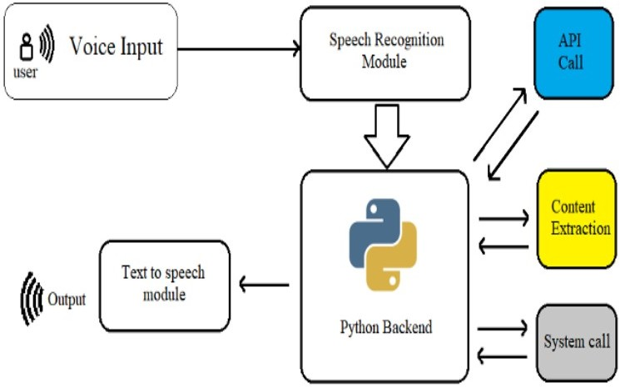
PROPOSED SYSTEM AND MODEL
Research and Requirements Analysis
Voice Recognition and Natural Language Processing
Task Automation and Integration
User Interface and Interaction Design
Security and Privacy
Budget and Resources

Slide 9

References
John Doe et al., "Advancements in Natural Language Processing," IEEE Transactions on AI, 20XX https://www.jetir.org/papers/JETIR2003165.pdf
Mark Johnson et al., "User-Centric Evaluation of Virtual Assistant Performance," IEEE International Conference on Human-Computer Interaction, 20XX. https://www.jetir.org/papers/JETIR2003165.pdf
Artificial Intelligence Project Ideas for 2023 - DataFlair (data-flair.training)
Python code for Artificial Intelligence: Foundations of Computational Agents - David L. Poole and Alan K. Mackworth
https://nevonprojects.com/voice-based-intelligent-virtual-assistance-for-windows/
https://www.academia.edu/40229169/PROJECT_REPORT_ON_VIRTUAL_ASS ISTANT_SUBMITTED_BY_NAAZNEEN_JAT

Slide 10
Thank you

